Slide 1

Everest Re Group - Economic Capital
Presenters
Mingyu Zhang
Qiyu Zhan
Yogesh Rohra
Yunxuan Hou
2022/4/13

Slide 2
Agenda
Economic capital calculation and error analysis
Conclusion
Recommendation

Slide 3
Part 1：Economic capital calculation and error analysis

Slide 4
Assumptions In General
1. The numbers in the model are all presented in $ millions.
2. All of the risks are independent of each other.
3. All of the outputs are simulated 10,000 times.

Slide 5

Asset Risk
Asset risk is the risk of negative changes in the value of invested assets.
For example, stocks may decline, interest rates may rise causing bonds values to decrease, etc.

Slide 6
Asset Risk
Assumptions: assets are divided into three categories and can be represented by an appropriate Vanguard fund:
• AAA bonds: like VSBSX (short-term treasury bond fund)
• Other bonds: like VSCSX (short-term corporate bond fund)
• Equities: like VTSAX (total stock market index fund)
• Combine “Other invested assets”, as part of the equities
They are all modeled with lognormal distribution.

Slide 7
Asset Risk
Investments of 2021:
AAA bonds (VSBSX) | $ 9,729.8m
Other bonds (VSCSX) | $ 15,197.7m
Equities (VTSAX) | $ 4,745.9m
Total | $ 29,673.3m

Slide 8
Asset Risk
We found the historical data of VSBSX, VSCSX and VTSAX’s daily prices from Yahoo!finance.
First, we calculated the correlations:
VSBSX & VSCSX | 0.769
VSBSX & VTSAX | -0.064
VSCSX & VTSAX | 0.085

Slide 9
Asset Risk
Second, we calculated their yearly expected log-return and volatility:
 | VSBSX | VSCSX | VTSAX
Daily log return | -1.33% | -2.25% | 23.52%
Volatility | 0.74% | 1.28% | 13.67%

Slide 10
Asset Risk
Combining correlation, log-return and volatility, we built a model upon the Total investment.
Total investment = AAA bonds (VSBSX) + Other bonds (VSCSX) + Equities (VTSAX)

Slide 11
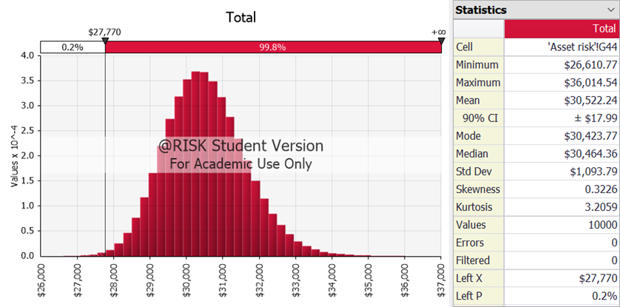
Asset Risk

Slide 12
Asset Risk
Conclusion:
Expected asset value is $ 30, 522.24m, but in the worst 0.4% of the cases, the expected asset value is $ 27,698m. So, the economic capital is their difference, which is $ 2823.87m.
Mean | 99.6% TVaR | Economic Capital
$ 30,522.24m | $ 27,694m | $ 2,828.08m

Slide 13

Catastrophe Risk
Assumptions:
Using PML estimates from 10K, model the California earthquake, Southeast wind, and Texas wind losses with the Poisson-lognormal model.
Calculate combined loss at different probability, assuming three catastrophes are independent of each other
Consider 4 billion Catastrophic bonds as the worst-case scenario for the exposure.

Slide 14
Catastrophe Risk Process
Step 1: Estimate the potential risk exposure brought by three types of catastrophe, use the scenarios presented in 10k, and model its severity and frequency for each catastrophe occurring.
Step 2: Limit its exposure to a max of USD 4 billion, our team consider 4 billion as the risk ceiling for the total loss of catastrophe risk.
Step 3: Extracted Probable Maximum Loss (PML) data for each scenario, then used the fit function to create three lognormal distributions to model each loss distribution.
Step 4: Our team used the Riskcompound function to combine the two distributions, and created a Poisson-lognormal (LN) model for each catastrophe, retrieving cumulative loss depending on the frequency.
Step 5: Combined three results into one Poisson-LN model, assuming correlation = 0, and calculate the corresponding TVaR (5%, 2%,1%, 0.4%,0.2%, 0.1%). After 10000 simulations, the Minimum loss at 99.6 TVaR.

Slide 15
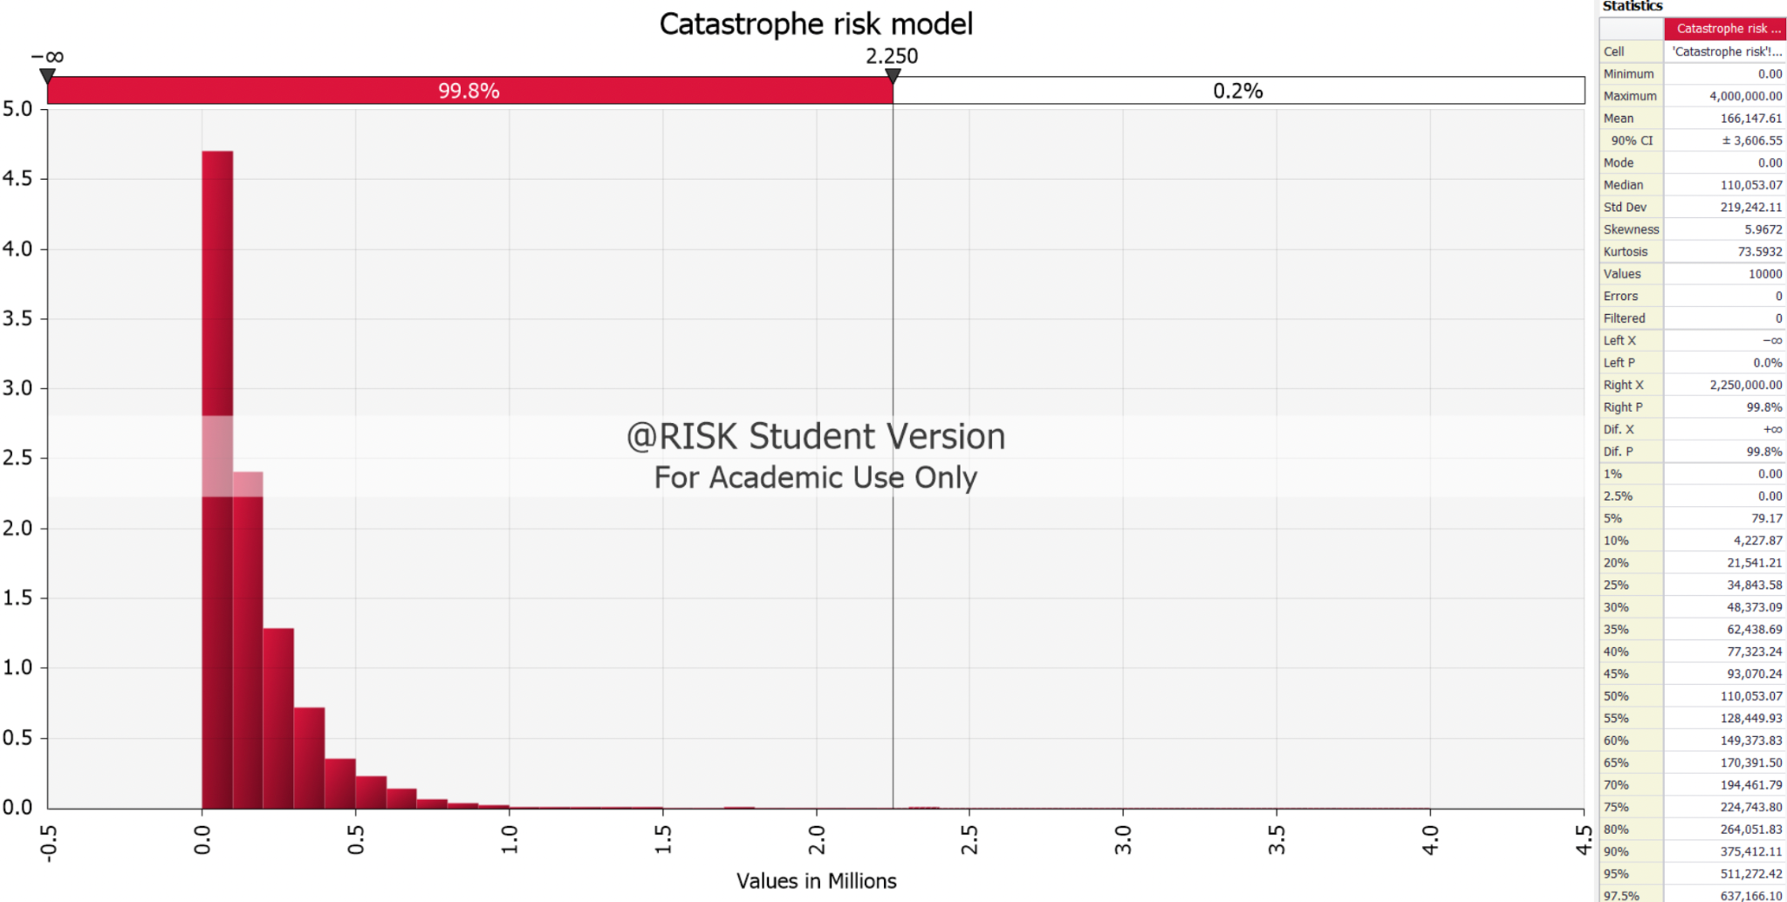
Economic Capital of Catastrophe Risk
Mean | $ 163.48m
TVaR | $ 2194.81m
xTVaR | $ 2031.33m

Slide 16
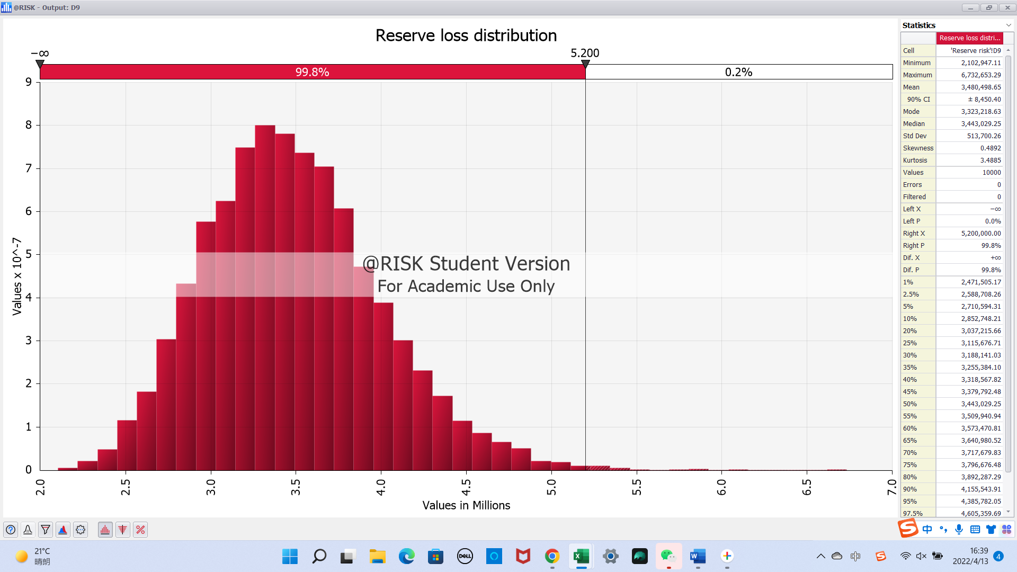
Reserve Risk:
Combine the log-normal models of 6 business lines:
Economic capital:
$ 1974.461m

Slide 17
Premium Risk
Through the OLS linear regression，we could get:
2022 premium loss ratio: 60.57%
2022 premium value
Then we can get the premium model by multiple the two.

Slide 18
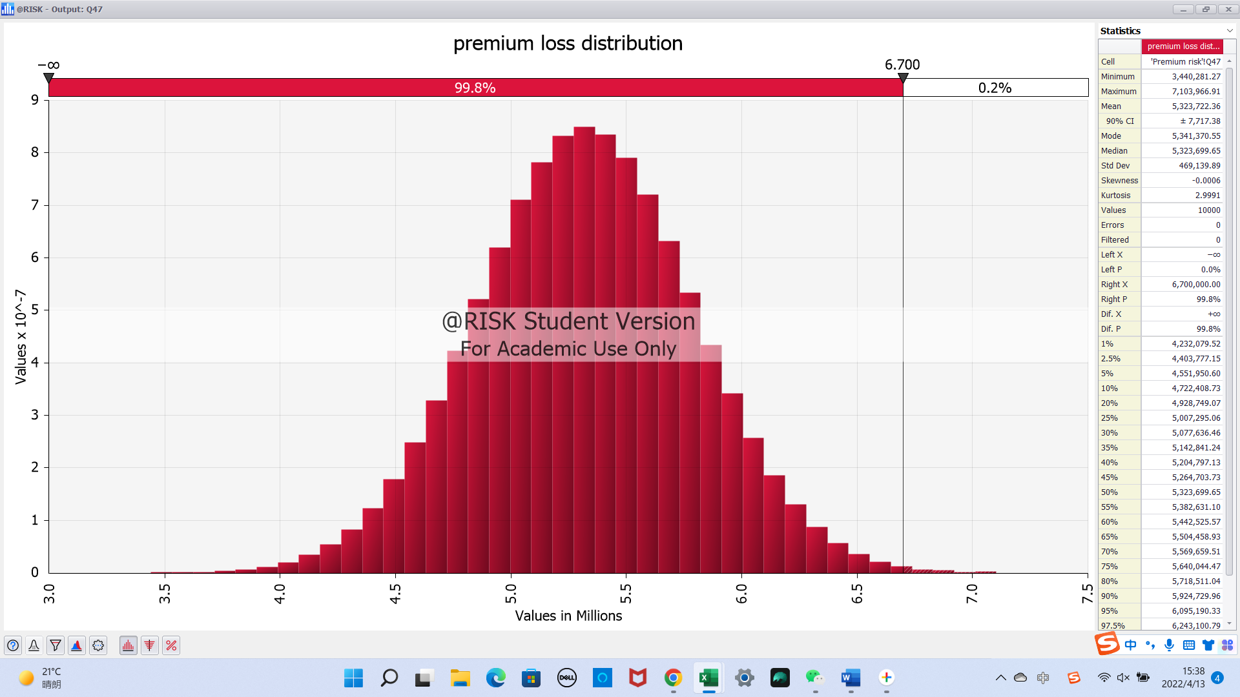
Premium Risk
Economic capital:
$ 1385.04m

Slide 19
Aggregation: Profit Model
Formula: Profit=Premium+Growth-Overhead -Claim
Stable value: (OLS linear regression)
Premium：8789.38million
Overhead：2481.72 million
Variable value:
Growth: Asset risk model
Claim: Reserve risk model; Catastrophe model; Premium risk model
Through combine the four parts, we could get the profit model.

Slide 20
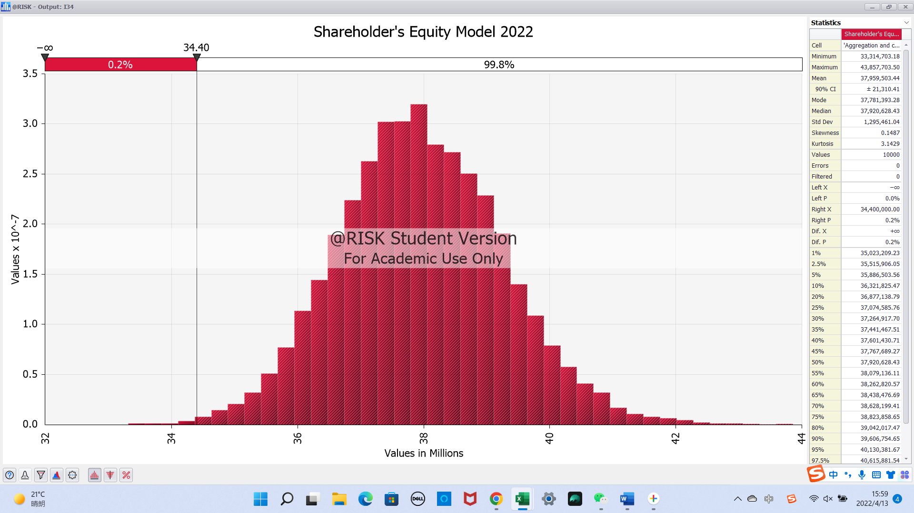
Aggregation: Shareholder’s equity model
The Shareholders’ equity at December 31, 2021 was $10.1 billion.(10-k)
So we can build the shareholder’s model by using profit model plus 10.1 billion.
Economic capital:
$ 3820.36m

Slide 21
Error Analysis：
Model specification risk: Happens everytime when we use model especially in catastrophe risk(fitting) and the OLS linear regression.
Parameter risk：Reserve risk; Asset risk; Catastrophe risk
Process risk：Everytime when we simulate.

Slide 22
Part 2：Conclusion

Slide 23
Conclusion: Individual economic capital
Asset risk：2,828.08m (MAX)
Catastrophe risk: 2031.33m
Premium risk: 1385.04m
Reserve risk: 1974.46m
Comparing the four we find that the asset risk is driving the economic capital.

Slide 24
Conclusion: Sensitivity Analysis
Experimental conditions：
The original model
The model without one kind of risk
By comparing the difference of the economic capital between the two, we could get the most sensitive input.

Slide 25
Conclusion: Sensitivity Analysis
The difference of economic capital:
Without asset risk: 1835.09 m (MAX)
Without catastrophe risk: 274.71 m
Without premium risk: 134.84 m
Without reserve risk: 140.41 m
Comparing the four we find that the asset risk the input we have to concern most.

Slide 26
Part 3：Recommendation

Slide 27
Recommendation:
Comparing the economic capital and actual capital:
Economic capital: 3820.36m(2022)
Actual capital: 5789.5m(2021-10k)
We can see that the economic capital still has room to increase, and based on risk-reward strategy, we recommend increasing asset exposure.

Slide 28
Thank you
Please feel free to reach out at
Mingyu Zhang mz2852@columbia.edu
Qiyu Zhan qz2459@columbia.edu
Yogesh Rohra yar2115@columbia.edu
Yunxuan Hou yh3423@columbia.edu

